Slide 1

PROJECT SQL

Slide 2
CAR SALES
DATA SET
ABOUT
I SELECTED THIS DATA SET BECAUSE , IN OUR DAY TO DAY LIFE THE PRODUCTION OF VEHICLES IS GROWING HIGHLY, ESPECIALLY CARS. SO, I HOPE THERE’S A HUGE SCOPE TO ANALYSE THE DATASET.
NOW THESE DAYS EVERY FAMILY HAS ATLEAST ONE CAR IN THEIR FAMILY. SO, THERE’S A HUGE NUMBER OF CARS PRODUCING EVERY DAY BY CAR COMPANIES.
THERE ARE TWO TYPE OF CARS I TOOKED FOR ANALYSE IN THIS DATASET.
ONE IS PASSENGER CARS ,
ANOTHER ONE IS SPORTS CARS.
THIS DATASET WILL SHOW US THE DEMAND OF CARS AND WHICH TYPE CARS ARE SELLING IN HIGH DEMAND.

Slide 3
FIRST OF ALL, WE’VE TO CREATE DATABASE FOR USE THE DATASET.
CREATE DATA BASE PROJECT;
USE PROJECT;
HERE WE GAVE THE DATABASE NAME PROJECT,
THEN IMPORT THE DATASET INTO THE CREATED TABLE.
THE TABLE NAME IS CAR_SALES.

Slide 4
COLUMNS AND IT’S NAMES
IN THIS DATASET THERE’S 16 COLUMNS, ITS ARE GIVEN BELOW.
Manufacturer , Model, Sales_in_thousands, __year_resale_value,
Vehicle_type, Price_in_thousands , Engine_size , Horsepower,
Wheelbase , Width, Length , Curb_weight , Fuel_capacity,
Fuel_efficiency, Latest_Launch , Power_perf_factor .
BY USING THESE COLUMNS WE CAN ANALYSE THE DATASET.

Slide 5
QUESTIONS AND QUERYS
?
?
?
?
?
?
?

Slide 6
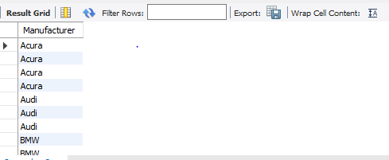
Q.1 Show manufacturer names.
select Manufacturer from Car_sales;

Slide 7
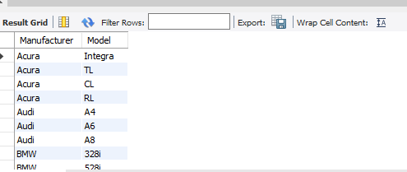
Q2. show manufacturer and model names
select Manufacturer, Model from Car_sales;

Slide 8
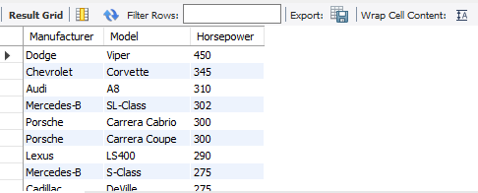
Q3. Show manufacturer , model, Horsepower when Horsepower greater than 160 HP
select Manufacturer, Model, Horsepower from Car_sales where Horsepower >160 order by Horsepower desc;

Slide 9
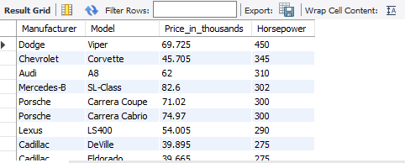
Q4. show Manufacturer, Model , Price_in_thousands, Horsepower in ascending order related to column 'Horse power'
select Manufacturer, Model , Price_in_thousands, Horsepower from Car_sales order by Horsepower desc ;

Slide 10
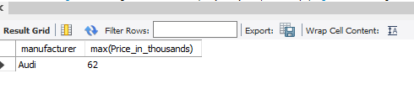
Q5. show Price_in_thousands of Manufacturer Audi
select manufacturer , max(Price_in_thousands) from Car_sales where Manufacturer="Audi";

Slide 11
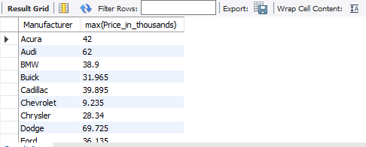
Q6. show maximum Price_in_thousands of Manufacturer
select Manufacturer, max(Price_in_thousands) from Car_sales group by Manufacturer;

Slide 12
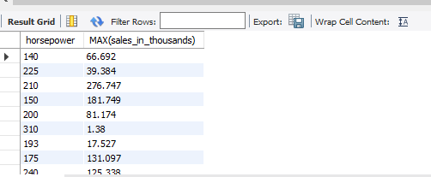
Q7. show maximum Sales_in_thousands of Horsepower
select Horsepower , max(sales_in_thousands) from Car_sales group by Horsepower;

Slide 13
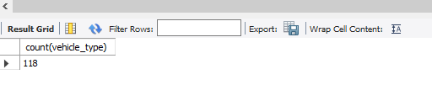
Q8. How many items in vehicle_type
select count(vehicle_type) from Car_sales;

Slide 14
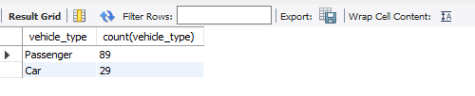
Q9. Show types of vehicle_type
select vehicle_type, count(vehicle_type) from Car_sales group by vehicle_type;

Slide 15
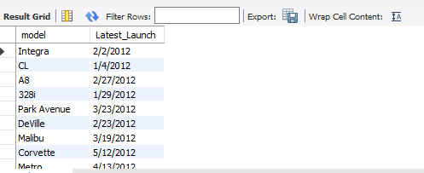
Q10. show the models that launched in 2012
select model, Latest_Launch from car_sales where Latest_Launch like '%2012' ;

Slide 16
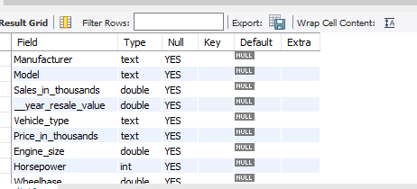
Q11.How to see the types of columns
Describe car_sales;

Slide 17
-CONCLUTION-
THANK YOU

